Slide 1

Azure Cognitive Search
John Miner Data Architect
john.miner@insight.com

Slide 2
Purpose
Many companies have data stored in multiple source systems. How can you add value to the data you already have as well as provide the ability to search for items of interest?
Today, we are going to talk about how Azure Cognitive Search can be used to index this data for search.
We will be using sample data stored in Data Lake Storage as files, Cosmos Database as documents or SQL Server as records in our exploration.

Slide 3
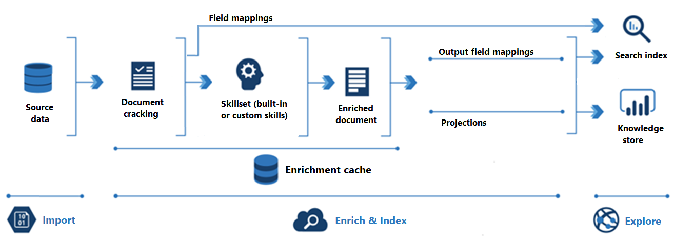
Architectural Overview

Slide 4
Search Concepts
Data Source – How to connect to an Azure Service to ingest data.
Index – The ingested data in JSON documents.
Indexer – How and when to index data.
Skillset – Additional AI processing can happen during document cracking.
Search – Simple web interface to ask questions and get results.

Slide 5
Supported Data Sources
Azure Storage – All types.
Azure Cosmos DB – JSON documents are the most popular.
Azure SQL Database – Many types.
Azure SharePoint – In preview.

Slide 6
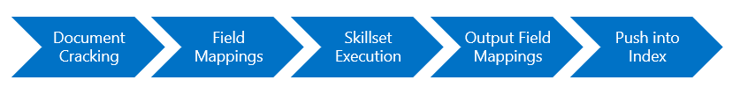
Index Loading
The above image shows the processing that happens when loading an index.
Data can be programmatically loaded via SDK language calls or indexer defined in the service.
Additional skillset steps (AI) can be called to enrich the raw data.

Slide 7
Sample Data Sources
Grimm Tales – ANSI text stored in Azure Data Lake Storage.
Stock Data – JSON stored in the COSMOS database.
Adventure Works – Simple SQL Server database schema.

Slide 8
Search Design
Datasets
ds-grimm-tales
ds-stock-docs
ds-advwrks-db
Indexes
idx-grimm-tales
idx-stock-docs
idx-advwrks-db
Indexers
idxr-grimm-tales
idxr-stock-docs
idxr-advwrks-db
* - Three separate indexes allows for re-loading of data for one section without impacting others.

Slide 9
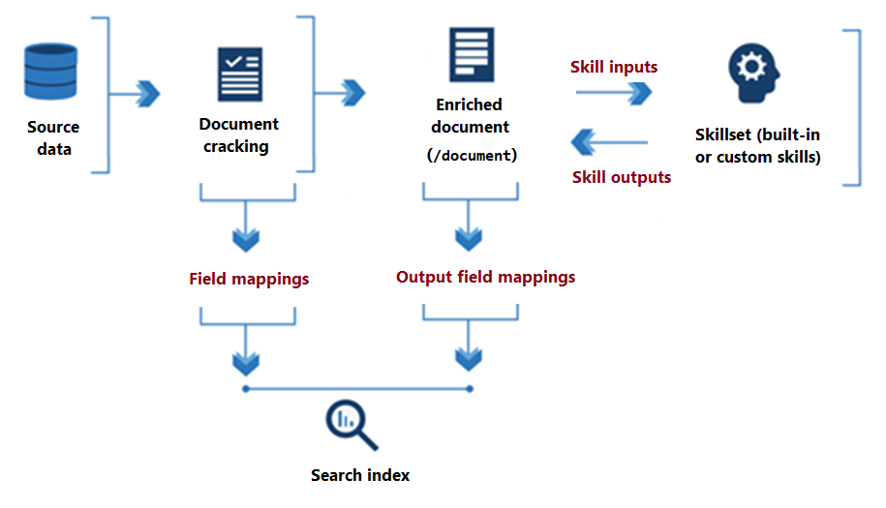
Processing Skillsets

Slide 10
Interesting Skillsets
Document Extraction – Convert WORD and PDF documents to text.
Key Phrase Extraction – Just words that matter.
Language Detection – What language is the information in?
OCR – Convert handwriting to text.
PII Detection – Is there confidential data in the text?
Sentiment Analysis – Is this good or bad comments?
Text Translation – Convert English text into Spanish text.

Slide 11
Engines vs Results
Types:
Microsoft – This simple engine is part of SQL Server full text indexing.
Lucent – Another engine supports regular expressions or fuzzy matches.
Results:
Microsoft finds all 7 Grimm Fairy Tales with the word wolf.
Lucent finds only 3 Grimm Fairy Tales with the word wolf.

Slide 12
Search Key Words
Here are some key words to pass to the service as query parameters.
Search – what to look for.
SearchMode – any or all documents
SearchFields – what fields to search.
Select – what fields to return.
Top – top n matches.
Count – include count of matches.
OrderBy – order the results

Slide 13
Facets
Facets can be calculated over single-value fields as well as collections. Fields that work best in faceted navigation have these characteristics:
Low cardinality (a small number of distinct values that repeat throughout documents in your search corpus).
Short descriptive values (one or two words) that will render nicely in a navigation tree.

Slide 14
About Indexes
The information in the index is only as current as the last time the indexer ran. This is a pull data into the service design. An indexer can rebuild the index if needed.
Data can be pushed into the search via coding using the software development kits that are available.
The indexer uses change detection to load new or updated information. Storage and SharePoint have built in mechanisms for detecting change. Other services such as Cosmos use a highwater mark and timestamp to find changes.

Slide 15
Summary
The Azure Cognitive Search engine allows the modern applications developer to create an index for information that might be stored in several places such as Storage, NoSQL or SQL. The engine stores the index entries as JSON documents. Indexes can be enriched by using skillsets to add additional information. For instance, translate that text from English to Spanish. Finally, searches will return results ranked by scoring.
If you application can group information by key words, consider using facets. This will allow you to place an additional bread crumb on the results page to quickly drill into the information that you want.
Since the design uses three indexes, it is suggested to use an API interface that can search using any or all the indexes.

Slide 16
References
Azure Cognitive Search
https://learn.microsoft.com/en-us/azure/search/
Indexing
https://learn.microsoft.com/en-us/azure/search/search-what-is-an-index
Enrichment
https://learn.microsoft.com/en-us/azure/search/cognitive-search-concept-intro
Search
https://learn.microsoft.com/en-us/azure/search/search-lucene-query-architecture
Facets
https://learn.microsoft.com/en-us/azure/search/search-faceted-navigation

Slide 17
Questions / Thank You

